Slide 1

CS420 Machine Learning Project
Ruiheng Chang, 515021910459
Weichao Mao, 515021910559

Slide 2
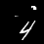



Overview
Target problem:
A classification problem on a modified MNIST dataset.
60000 training samples, 10000 testing samples, 45×45.
Sample examples.

Slide 3
Results
Traditional methods:
KNN: 98.40% (without preprocessing: 88.12%).
SVM: 98.75% (without preprocessing: 93.22%).
Ensemble: 98.40%.

Slide 4



Preprocessing
Invert the artificial disturbance.
1. Original image
2. Denoised
3. Cropped
4. Centered
Preprocessing pipeline.

Slide 5
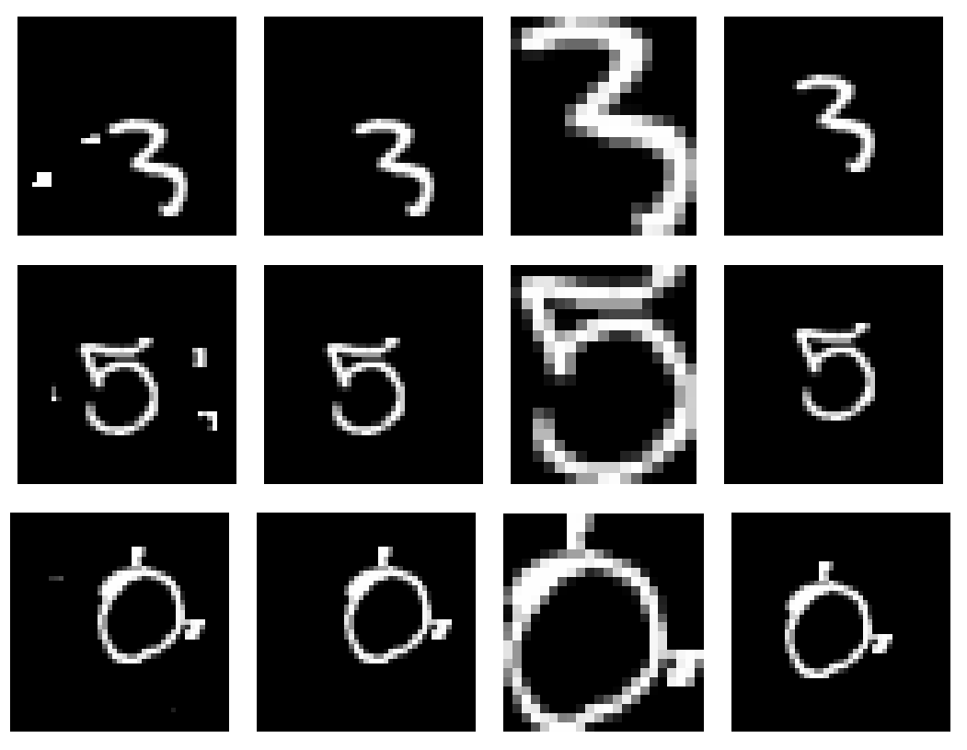
More Examples
Hough transform?
More examples of preprocessing, including a failure case.

Slide 6
KNN & SVM
KNN:
PCA ratio = 1.0, k = 1.
Accuracy: 98.40% (without preprocessing: 88.12%).
SVM
rbf kernel, PCA ratio = 0.85, C =5, gamma = 5e-7.
Accuracy: 98.75% (without preprocessing: 93.22%).

Slide 7

Ensemble Method
A soft voting classifier of KNN and SVM:
Accuracy: 98.40%. (Worse than SVM alone.)
Illustration of a voting classifier. Image source: https://www.toptal.com/machine-learning/ensemble-methods-machine-learning

Slide 8
Analysis
Only two voters (typically more than 100).
Variance is lowered by independence.
Details in the report.

Slide 9


THANKS

